Slide 1
M.A.C. REFLECTION
Kevin, Ryan, Steve

Slide 2
OVERVIEW
Project Overview
User Experience
Design Evolution
Project Reflection

Slide 3
Project Overview
Problem
Need a system to encourage communication between employees
Solution
The HAL Interconnection Network(THIN)
Social Media Messaging Application
Intended Audience
Employees of HAL Corporation

Slide 4
T.H.I.N.
What is it?
A company-wide social network
How does it work?
Users posts messages that can be seen by other users
Users can subscribe to other users to see everything they post
Users can also subscribe to certain topics designated by a #

Slide 5
Design Evolution
Group had no previous web development experience
Languages
Intended to use php, mysql, javascript
Dropped javascript
Started with MVC in mind
Shifted away because of impending deadlines/inexperience

Slide 6
Missing Features
UI design
Missing CSS
Requirements 2 and 14 were dropped from the required list of functionalities
Still Implementing:
Requirement 4-Password Strength
Requirement 13- Sorting Posts

Slide 7
Project Reflection Overview
What did we learn?
How could we have improved the project?
What is one thing we would change?
Key Technologies

Slide 8
What did we learn?
Crash course in web development
Teammate Problems
1 member was dropped
Division of Labor
Internal vs. External Deadlines

Slide 9
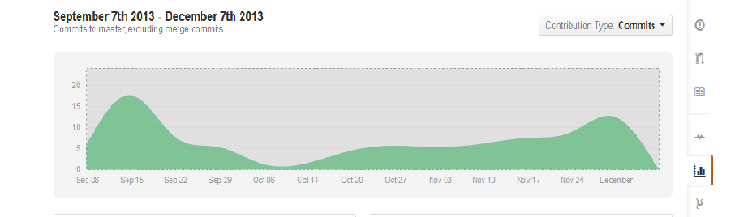
Commits
November 08 2013 - December 08 2013:
3 authors have pushed 55 commits to all branches, excluding merges. On master, 26 files have changed and there have been 3,809 additions and 0 deletions.

Slide 10
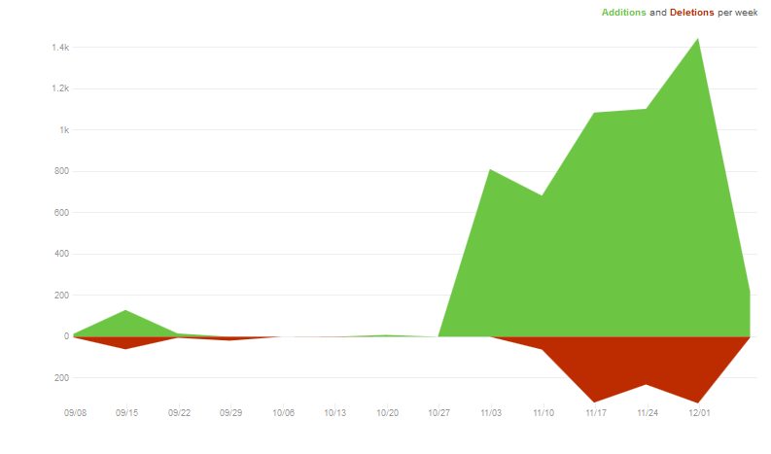
Code Frequency

Slide 11
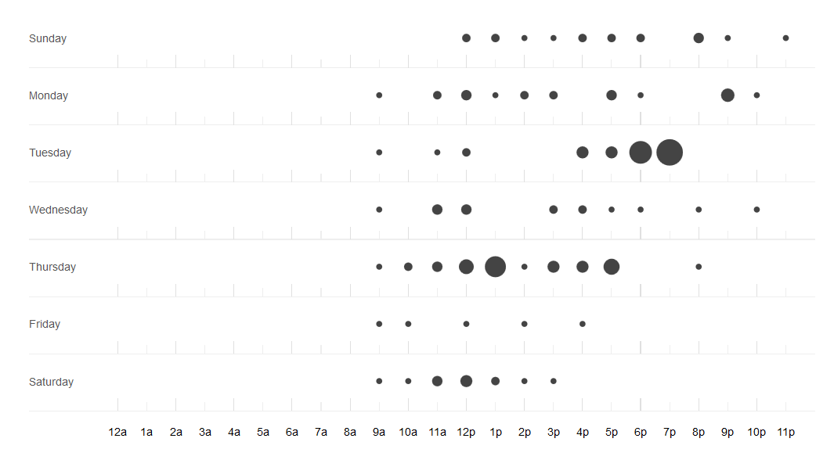
Punchcard

Slide 12
How could we have improved?
Meeting more frequently
Get with experience with web development
Have a full group
What is one thing we would change?
Focus on UI

Slide 13
Key Technology
Xampp- free apache webserver integrated with php and mysql
MySQLi-
GIT-dealing with merge conflicts

Slide 14

Questions

